Slide 1




Noida Institute of Engineering and Technology, Greater Noida
Stacks, Queues
Unit:2
Data Structure
ACSE0301
Alisha Sikri
Assistant Professor
Computer Science and Engineering
Course Details (Ex: B Tech 3rd Sem)

Slide 2

Faculty Profile
Noida Institute of Engineering and Technology, Greater Noida
Name: Alisha Sikri
Qualification: PhD (Pursuing)
Specialization Areas: Machine Learning, Artificial Intelligence
COURSE | BOARD/UNIVERSITY | YEAR OF PASSING
PhD | SRM University, NCR | Pursuing
M.Tech | DCRUST University, Murthal | 2016
B.Tech | MDU, Rohtak | 2014

Slide 3
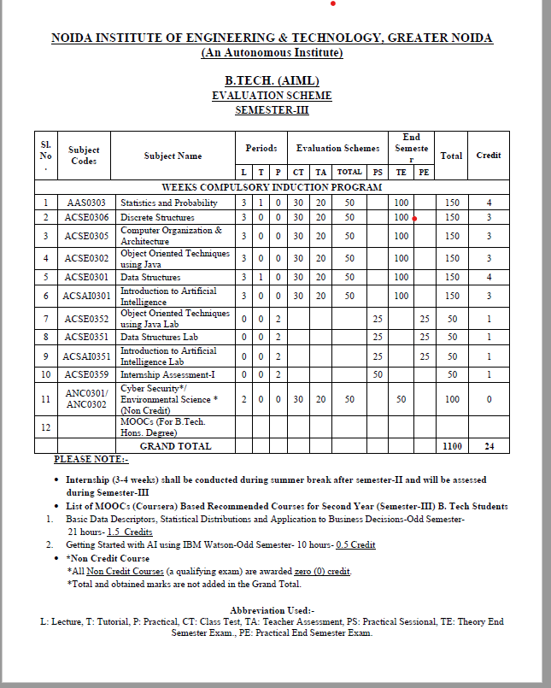
Evaluation Scheme

Slide 4
Syllabus
UNIT-2
Stacks: Primitive Stack operations: Push & Pop, Array and Linked Implementation of Stack, Application of stack: Infix, Prefix, Postfix Expressions and their mutual conversion, Evaluation of postfix expression.
Recursion: Principles of recursion, Tail recursion, Removal of recursion, Problem solving using iteration and recursion with examples such as binary search, Fibonacci series, and Tower of Hanoi, Trade-offs between iteration and recursion.
Queues: Array and linked implementation of queues, Operations on Queue: Create, Insert, Delete, Full and Empty, Circular queues, Dequeue and Priority Queue.

Slide 5
Contents
Topics | Duration (in Hours)
Stacks: Abstract Data Type | 1
Array and Linked Implementation of Stack in Python | 1
Application of stack: Prefix and Postfix Expressions | 1
Evaluation of postfix expression | 1
Iteration and Recursion- Principles of recursion | 1
Binary search using recursion | 1
Hanoi towers | 1
Tradeoffs between iteration and recursion. | 2

Slide 6
Contents
Topics | Duration (in Hours)
Queues: Operations on Queue | 1
Circular queues | 1
Array and linked implementation of queues in Python | 1
Dequeue | 1
Priority Queue | 1

Slide 7
Objective of Unit
Objective of the course is to make students able to:
Learn the basic types for data structure, implementation and application.
Know the strength and weakness of different data structures.
3. Use the appropriate data structure in context of solution of given problem.
4. Develop programming skills which require to solve given problem.

Slide 8

Course Outcome
CO | CO Description | Bloom’s Knowledge Level (KL)
CO 1 | Describe the need of data structure and algorithms in problem solving and analyze Time space trade-off. | K2, K4
CO 2 | Describe how arrays are represented in memory and how to use them for implementation of matrix operations, searching and sorting along with their computational efficiency. | K2, K6
CO 3 | Design, implement and evaluate the real-world applications using stacks, queues and non-linear data structures. | K5, K6
CO 4 | Compare and contrast the advantages and disadvantages of linked lists over arrays and implement operations on different types of linked list. | K4, K6
CO 5 | Identify and develop the alternative implementations of data structures with respect to its performance to solve a real-world problem. | K1, K3, K5, K6

Slide 9
Program Outcomes (POs)
1. Engineering knowledge
2. Problem analysis
3. Design/development of solutions
4. Conduct investigations of complex problems
5. Modern tool usage
6. The engineer and society
7. Environment and sustainability
8. Ethics
9. Individual and team work
10. Communication
11. Project management and finance
12. Life-long learning

Slide 10
CO-PO Mapping
CO-PO correlation matrix of Data Structure (KCS 301)
 | PO1 | PO2 | PO3 | PO4 | PO5 | PO6 | PO7 | PO8 | PO9 | PO10 | PO11 | PO12
ACSE0301.1 | 3 | 3 | 3 | 2 | - | 1 | - | 1 | 2 | 2 | 2 | 2
ACSE0301.2 | 3 | 3 | 2 | 2 | - | 1 | - | 1 | 2 | 2 | 1 | 2
ACSE0301.3 | 3 | 3 | 2 | 2 | - | 1 | - | 1 | 2 | 2 | 2 | 2
ACSE0301.4 | 3 | 3 | 2 | 2 | - | 1 | - | 1 | 2 | 2 | 2 | 2
ACSE0301.5 | 3 | 3 | 3 | 3 | 2 | 2 | 2 | 2 | 3 | 3 | 3 | 3
Average | 3 | 3 | 2.4 | 2.2 | 0.4 | 1.2 | 0.4 | 1.2 | 2.2 | 2.2 | 2 | 2.2

Slide 11
Program Specific Outcomes (PSOs)
On successful completion of graduation degree the Engineering graduates will be able to:
PSO1: The ability to design and develop the hardware sensor device and related interfacing software system for solving complex engineering problem.
PSO2: The ability to understanding of Inter disciplinary computing techniques and to apply them in the design of advanced computing .
PSO 3: The ability to conduct investigation of complex problem with the help of technical, managerial, leadership qualities, and modern engineering tools provided by industry sponsored laboratories.
PSO 4: The ability to identify, analyze real world problem and design their solution using artificial intelligence ,robotics, virtual. Augmented reality ,data analytics, block chain technology and cloud computing.

Slide 12
CO-PSO Mapping
Mapping of Program Specific Outcomes and Course Outcomes
 | PSO1 | PSO2 | PSO3 | PSO4
ACSE0301.1 | 3 | 3 | 2 | 2
ACSE0301.2 | 3 | 3 | 2 | 3
ACSE0301.3 | 3 | 3 | 2 | 2
ACSE0301.4 | 3 | 3 | 3 | 3
ACSE0301.5 | 3 | 3 | 3 | 3
Average | 3 | 3 | 2.4 | 2.6

Slide 13
Prerequisite and Recap
1. Stack is a container of objects that are inserted and removed according to the last-in first-out (LIFO) principle.
2. Queue is a container of objects (a linear collection) that are inserted and removed according to the first-in first-out (FIFO) principle.

Slide 14
Stack and Queue(CO2)
Topic mapping with Course Outcome
Topic | CO1 | CO2 | CO3 | CO4 | CO5
Stack | - | 2 | - | - | -
Queue | - | 2 | - | - | -

Slide 15
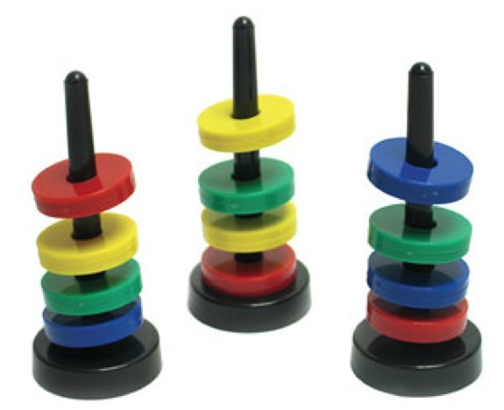
Stack
Introduction to Stack
A stack is a data structure in which items can be inserted only from one end and get items back from the same end.
There , the last item inserted into stack, is the the first item to be taken out from the stack. In short its also called Last in First out [LIFO].

Slide 16


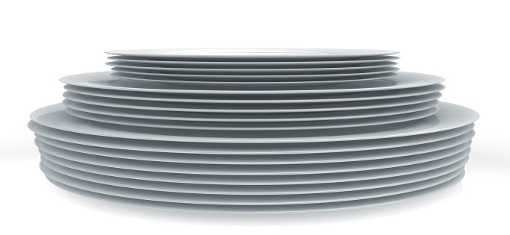
Example of Stack (LIFO)
Introduction to Stack
●
A Stack of book on table.
●
Token stack in Bank.
Stack of trays and plates.
●

Slide 17
Stack Operations
Introduction to Stack
Top: Open end of the stack is called Top, From this end item can be inserted.
Push: To insert an item from Top of stack is called push operation. The push operation change the position of Top in stack.
POP: To put-off, get or remove some item from top of the stack is the pop operation, We can POP only only from top of the stack.

Slide 18
Stack Operations
Introduction to Stack
IsEmpty: Stack considered empty when there is no item on Top. IsEmpty operation return true when no item in stack else false.
IsFull: Stack considered full if no other element can be inserted on top of the stack. This condition normally occur when stack implement ed through array.

Slide 19
Stack Abstract Data Type
Introduction to Stack
ADT Stack {
Data/Attributes/Values:
int size; Top Type items;
Functions/Operations:
CreateStack (int size); --create stack of size Void Push(int n); - - if stack is not full
Type Pop(); - - if stack is not empty return top item Int isEmpty(); - - return true if empty otherwise false Int isFull(); - - return true if full otherwise false }

Slide 20
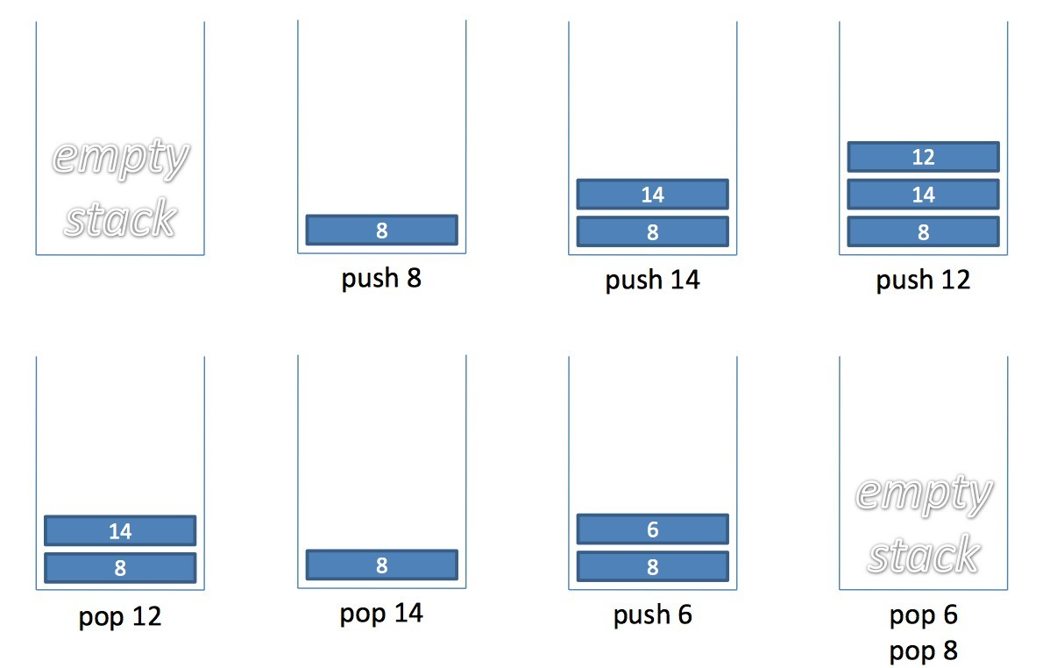
Stack Example
Introduction to Stack

Slide 21
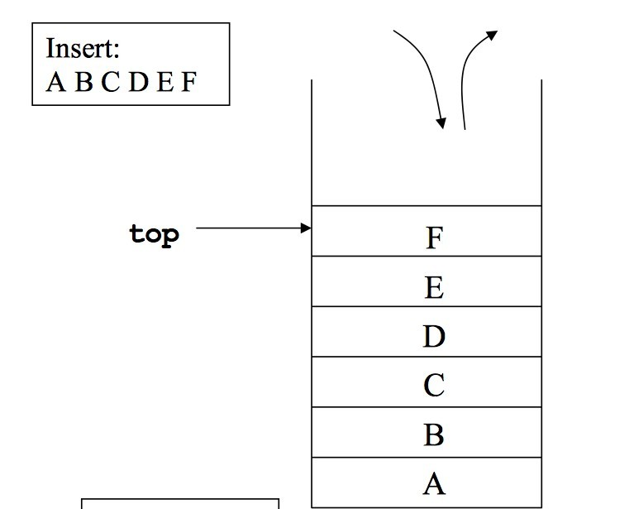
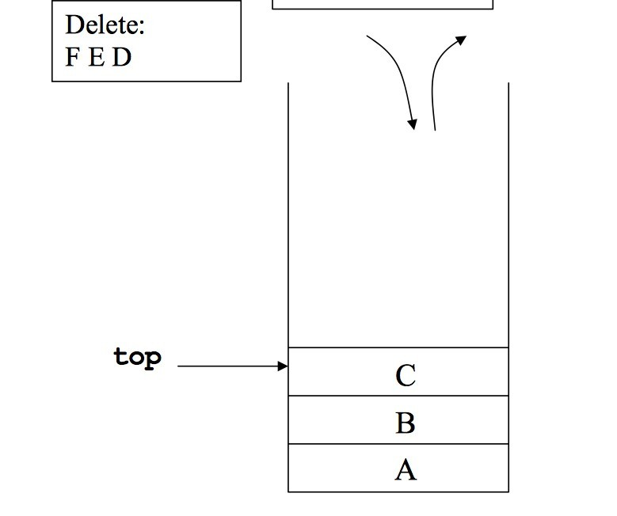
Introduction to Stack
Implementation of Stack
Using Array
Using Link List

Slide 22
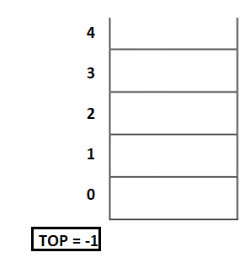
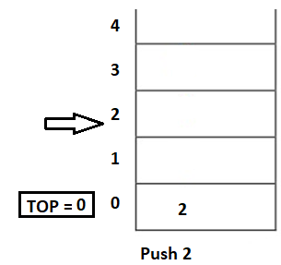
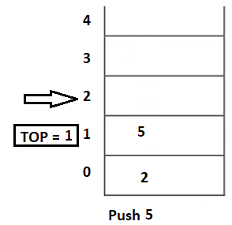
Stack Implementation using Array ...
Introduction to Stack

Slide 23
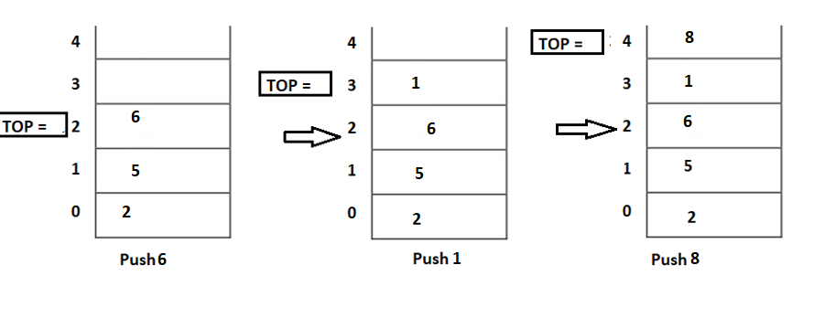
Introduction to Stack

Slide 24
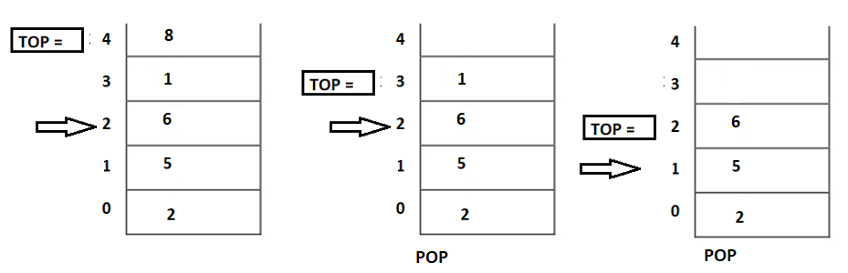
Introduction to Stack

Slide 25
Stack Implementation using Array using array
Introduction to Stack
A stack can be implemented using array as follows...
Before implementing actual operations, first follow the below steps to create an empty stack.
Step 1 - Include all the header files which are used in the program and define a constant 'SIZE' with specific value.
Step 2 - Declare all the functions used in stack implementation.
Step 3 - Create a one dimensional array with fixed size (int stack[SIZE])
Step 4 - Define a integer variable 'top' and initialize with '-1'. (int top = -1)
Step 5 - In main method, display menu with list of operations and make suitable function calls to perform operation selected by the user on the stack.

Slide 26
push(value) - Inserting value into the stack using array
Introduction to Stack
In a stack, push() is a function used to insert an element into the stack. In a stack, the new element is always inserted at top position. Push function takes one integer value as parameter and inserts that value into the stack. We can use the following steps to push an element on to the stack...
Step 1 - Check whether stack is FULL. (top == SIZE-1)
Step 2 - If it is FULL, then display "Stack is FULL!!! Insertion is not possible!!!" and terminate the function.
Step 3 - If it is NOT FULL, then increment top value by one (top++) and set stack[top] to value (stack[top] = value).

Slide 27
Introduction to Stack
pop() - Delete a value from the Stack using array
In a stack, pop() is a function used to delete an element from the stack. In a stack, the element is always deleted from top position. Pop function does not take any value as parameter. We can use the following steps to pop an element from the stack...
Step 1 - Check whether stack is EMPTY. (top == -1)
Step 2 - If it is EMPTY, then display "Stack is EMPTY!!! Deletion is not possible!!!" and terminate the function.
Step 3 - If it is NOT EMPTY, then delete stack[top] and decrement top value by one (top--).

Slide 28
Introduction to Stack
display() - Displays the elements of a Stack using array
We can use the following steps to display the elements of a stack...
Step 1 - Check whether stack is EMPTY. (top == -1)
Step 2 - If it is EMPTY, then display "Stack is EMPTY!!!" and terminate the function.
Step 3 - If it is NOT EMPTY, then define a variable 'i' and initialize with top. Display stack[i] value and decrement i value by one (i--).
Step 3 - Repeat above step until i value becomes '0'.

Slide 29
Stack Implementation using Link List
Introduction to Stack
The major problem with the stack implemented using an array is, it works only for a fixed number of data values.
Stack implemented using an array is not suitable, when we don't know the size of data which we are going to use.
Stack implemented using linked list works for the variable size of data.
So, there is no need to fix the size at the beginning of the implementation.

Slide 30
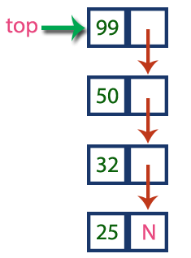
Stack Implementation using Link List
Introduction to Stack
In linked list implementation of a stack, every new element is inserted as 'top' element. That means every newly inserted element is pointed by 'top’.
Whenever we want to remove an element from the stack, simply remove the node which is pointed by 'top' by moving 'top' to its previous node in the list. The next field of the first element must be always NULL.

Slide 31
Stack Implementation using Link List
Introduction to Stack
To implement a stack using a linked list, we need to set the following things before implementing actual operations.
Step 1 - Include all the header files which are used in the program. And declare all the user defined functions.
Step 2 - Define a 'Node' structure with two members data and next.
Step 3 - Define a Node pointer 'top' and set it to NULL.
Step 4 - Implement the main method by displaying Menu with list of operations and make suitable function calls in the main method.

Slide 32
Introduction to Stack
push(value) - Inserting an element into the Stack using Link List
We can use the following steps to insert a new node into the stack...
Step 1 - Create a newNode with given value.
Step 2 - Check whether stack is Empty (top == NULL)
Step 3 - If it is Empty, then set newNode → next = NULL
.
Step 4 - If it is Not Empty, then set newNode → next = top.
Step 5 - Finally, set top = newNode.

Slide 33
Introduction to Stack
pop() - Deleting an Element from a Stack using Link List
We can use the following steps to delete a node from the stack...
Step 1 - Check whether stack is Empty (top == NULL).
Step 2 - If it is Empty, then display "Stack is Empty!!! Deletion is not possible!!!" and terminate the function
Step 3 - If it is Not Empty, then define a Node pointer 'temp' and set it to 'top’.
Step 4 - Then set 'top = top → next’.
Step 5 - Finally, delete 'temp'. (free(temp)).

Slide 34
Introduction to Stack
display() - Displaying stack of elements using Link List
We can use the following steps to display the elements (nodes) of a stack...
Step 1 - Check whether stack is Empty (top == NULL).
Step 2 - If it is Empty, then display 'Stack is Empty!!!' and terminate the function.
Step 3 - If it is Not Empty, then define a Node pointer 'temp' and initialize with top.
Step 4 - Display 'temp → data --->' and move it to the next node. Repeat the same until temp reaches to the first node in the stack. (temp → next != NULL).
Step 5 - Finally! Display 'temp → data ---> NULL'.

Slide 35
Stack Application
Introduction to Stack
Reversing a string: To reverse a string we can use following algorithm.
Given the sting and a stack
While there is not end of string, do the following.
Read a character form the string
Push it on the stack
End while
Re-initialize string position
While stack is not Empty, do the following.
Pop a character from the stack
Insert the character popped into next position in string.
End While

Slide 36
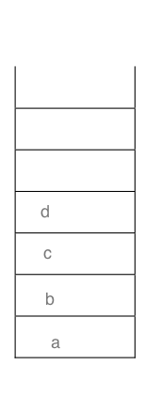
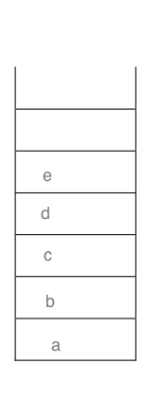
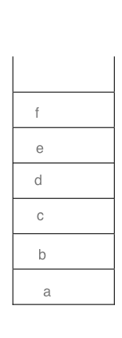
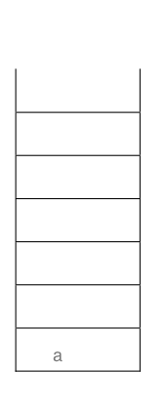
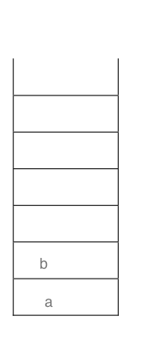
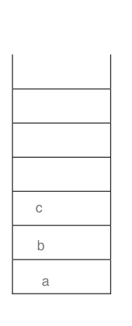
Reverse String...
Introduction to Stack
String is a b c d e f PUSH to SACK

Slide 37
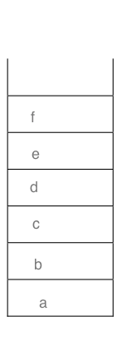
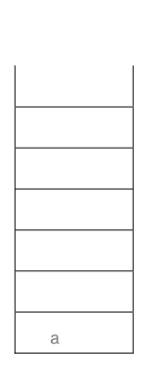
Reverse String...
Introduction to Stack
Reversed String: f e d c b a POP from SACK

Slide 38
Introduction to Stack
What is an Expression?
In any programming language, if we want to perform any calculation or to frame a condition etc., we use a set of symbols to perform the task. These set of symbols makes an expression. An expression can be defined as follows...
An expression is a collection of operators and operands that represents a specific value.
In above definition, operator is a symbol which performs a particular task like arithmetic operation or logical operation or conditional operation etc.,
Operands are the values on which the operators can perform the task. Here operand can be a direct value or variable or address of memory location

Slide 39
Introduction to Stack
Expression Types
Based on the operator position, expressions are divided into THREE types. They are as follows...
Infix Expression
Postfix Expression
Prefix Expression

Slide 40
Infix, Postfix and Prefix Expression
Introduction to Stack
Infix Expression: An expression in which the
operator is in between its two operands.
A+B
Prefix Expression: An expression in which operator precedes its two operands is called an prefix expression.
+AB
An expression in which
Postfix Expression:
operator follows its two operands is called a postfix expression.
AB+

Slide 41
Infix to Postfix Conversion
Introduction to Stack
Infix expression can be directly evaluated but the standard practice in CS is that the infix expression converted to postfix form and then the expression is evaluated.
During both processes stack is proved to be a useful data structure.

Slide 42
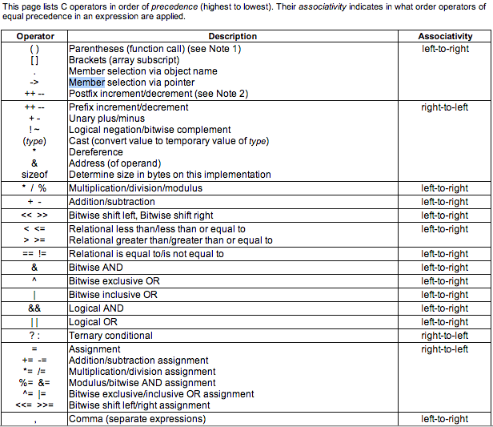
C language operators Precedence and Associativity
Introduction to Stack

Slide 43
Infix to Postfix By-Hand Algorithm
Introduction to Stack
Given a expression in the infix form.
Find the highest precedence operator
If there are more then one operators with the same precedence check associativity, i.e. pick the left most first.
Convert the operator and its operands from infix to postfix
(A + B) → A B+
Repeat steps 2 to 4, until all the operators in the given expression are in the postfix form.

Slide 44
Introduction to Stack
Q1. Convert the given infix expression 2*3/(2-1)+5*(4-1) to postfix expression
Sol.
Enclosed in brackets, based on precedence and associativity
2*3/(2-1)+5*(4-1)
(2*3)/(2-1)+5*(4-1)
((2*3)/(2-1))+(5*(4-1))
((2*3)/(2-1))+(5*(4-1))
((2*3)/(2-1))+(5*(4-1))
(((2*3)/(2-1))+(5*(4-1)))

Slide 45
Introduction to Stack
2. Convert each bracket in postfix expression one by one
a. (((2*3)/(2-1))+(5*(4-1)))
b. (((23*)/(2-1))+(5*(4-1)))
c. (((23*)/(21-))+(5*(4-1)))
d. (((23*)/(21-))+(5*(41-)))
e. (((23*)(21-)/)+(5*(41-)))
f. (((23*)(21-)/)+(5(41-)*))
f. (((23*)(21-)/)(5(41-)*)+)
Ans. 23*21-/541-*+
H.W
1. A+B*C-D^E^F

Slide 46
Infix to Prefix By-Hand Algorithm
Introduction to Stack
Given a expression in the infix form.
Find the highest precedence operator
If there are more then one operators with the same precedence check associativity, i.e. pick the left most first.
Convert the operator and its operands from infix to prefix A + B --> +A B
Repeat steps 2 to 4, until all the operators in the given expression are in the postfix form.

Slide 47
Infix to Prefix Step by Step Conversion
Introduction to Stack
Q1. A*B+C/D (Infix)
((A*B)+(C/D))
*AB+C/D
*AB+/CD
+*AB/CD (Prefix)
Q2. A*(B+C/D)
(A*(B+(C/D)) )
A*(B+/CD)
A*(+B/CD)
*A+B/CD
Exercise:
1. Infix ( (A * B) + (C / D) ) to Prefix
2.Infix ((A * (B + C) ) / D) to Prefix
3.Infix (A * (B + (C / D) ) ) to Prefix

Slide 48
Infix to Postfix using Stack (Convert in Reverse Polish Notation)
Introduction to Stack
Examine the given Input Sequence.
If it is operand output it.
If it is ‘(‘ push it on the stack.
If it is an operator and
If the stack is empty push it on the stack.
If the top of the stack is ‘(‘ then push it on to the stack.
If it has higher priority then top of the stack, push it on to the stack.
Otherwise pop operator from the stack and output it. And go to step 4.
If it is ‘)’ then pop of the operators from the stack and output them until ‘(‘ is encountered.
If there are more input sequence then go to step 1.
If there are no more input sequence, pop of remaining elements from the stack and output them.

Slide 49
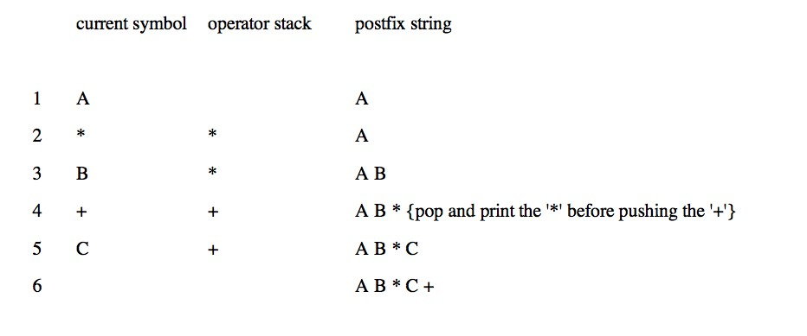
Introduction to Stack
Infix to Postfix using stack
●
Example A*B+C become AB*C+

Slide 50
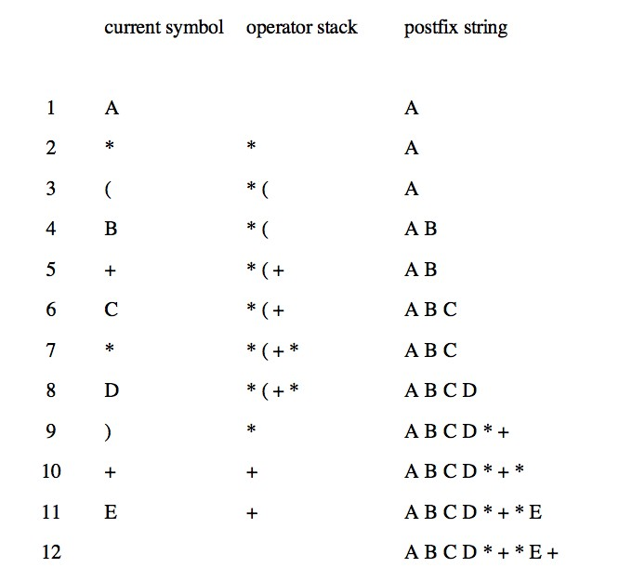
Introduction to Stack
Infix to Postfix using stack ...
Example A * (B + C * D) + E becomes A B C D * + * E +

Slide 51
Introduction to Stack
Infix to Prefix using Stack (Convert in Polish Notation)
First, reverse the given infix expression.
Scan the characters one by one.
If the character is an operand, print it .
If the character is a closing parenthesis, then push it to the stack.
If the character is an opening parenthesis, pop the elements in the stack until we find the corresponding closing parenthesis.
If the character scanned is an operator
If the operator has precedence greater than or equal to the top of the stack, push the operator to the stack.
If the operator has precedence lesser than the top of the stack, pop the operator and output it to the prefix notation output and then check the above condition again with the new top of the stack.
7. After all the characters are scanned, reverse the prefix notation output

Slide 52
Infix to Prefix using Stack..
Introduction to Stack
Step 1: Reverse the infix expression i.e A+B*C will become C*B+A. Note while reversing each ‘(‘ will become ‘)’ and each ‘)’ becomes ‘(‘.
Step 2: Obtain the postfix expression of the modified expression i.e CB*A+.
Step 3: Reverse the postfix expression. Hence in our example prefix is +A*BC.

Slide 53
Introduction to Stack
Algorithm for Prefix
Step 1: Reverse the infix string. Note that while reversing the string you must interchange left and right parentheses.
Step 2: Obtain the postfix expression of the infix expression Step 1.
Step 3: Reverse the postfix expression to get the prefix expression
This is how you convert manually for theory question in the exam
Input String - Infix – ((a/b)+c)-(d+(e*f))
String after reversal – ))f*e(+d(-)c+)b/a((
String after interchanging right and left parenthesis – ((f*e)+d)-(c+(b/a))
Apply postfix
Reverse Postfix Expression (Given After the table below)

Slide 54
Introduction to Stack
Infix – ((a/b)+c)-(d+(e*f)) → ))f*e(+d(-)c+)b/a(( → ((f*e)+d)-(c+(b/a))
Sr. no. | Expression | Stack | Prefix
0 | ( | (
1 | ( | ((
2 | f | (( | f
3 | * | ((* | f
4 | e | ((* | fe
5 | ) | ( | fe*
6 | + | (+ | fe*
7 | d | (+ | fe*d
8 | ) |  | fe*d+
9 | – | - | fe*d+
10 | ( | -( | fe*d+
11 | c | -( | fe*d+c
12 | + | -(+ | fe*d+c
13 | ( | -(+( | fe*d+c
14 | b | -(+( | fe*d+cb
15 | / | -(+(/ | fe*d+cb
16 | a | -(+(/ | fe*d+cba
17 | ) | -(+ | fe*d+cba/
18 | ) | - | fe*d+cba/+
19 |  |  | fe*d+cba/+- -+/abc+d*ef

Slide 55
Introduction to Stack
Infix – A*(B+D)/E-F*(G+H/K) --- > )K/H+G(*F-E/)D+B(*A -- > (K/H+G)*F-E/(D+B)*A
Sr. no. | Expression | Stack | Prefix
1 | ( | (
2 | K | ( | K
3 | / | (/ | K
4 | H | (/ | KH
5 | + | (+ | KH/
6 | G | (+ | KH/G
7 | ) |  | KH/G+
8 | * | * | KH/G+
9 | F | * | KH/G+F
10 | - | - | KH/G+F*
11 | E | - | KH/G+F*E
12 | / | -/ | KH/G+F*E
13 | ( | -/( | KH/G+F*E
14 | D | -/( | KH/G+F*ED
15 | + | -/(+ | KH/G+F*ED
16 | B | -/(+ | KH/G+F*EDB
17 | ) | -/ | KH/G+F*EDB+
18 | * | -/* | KH/G+F*EDB+
19 | A | -/* | KH/G+F*EDB+A
20 | - |  | KH/G+F*EDB+A*/-

Slide 56
Evaluating Arithmetic Postfix Expression
Introduction to Stack
1) Create a stack to store operands (or values). 2) Scan the given expression and do following for every scanned element. …..a) If the element is a number, push it into the stack …..b) If the element is a operator, pop two operands for the operator from stack. Evaluate the operator and push the result back to the stack 3) When the expression is ended, the number in the stack is the final answer

Slide 57
Evaluating Arithmetic Postfix Expression
Introduction to Stack
PostFix Expression 2 3 4 + * 5 *
Move | Token | Stack
1 | 2 | 2
2 | 3 | 2 3
3 | 4 | 2 3 4
4 | + | 2 7 (3+4=7)
5 | * | 14 (2*7=14)
6 | 5 | 14 5
7 | * | 70 (14*5=70)

Slide 58
Recursion
Introduction to Stack
Recursion is a process by which a function calls itself repeatedly, until some specified condition has been satisfied
The process is used for repetitive computations in which each action is stated in terms of a previous result.
To solve a problem recursively, two conditions must be satisfied.
First, the problem must be written in a recursive form
Second the problem statement must include a stopping condition

Slide 59
Types of Recursions: Recursion are mainly of two types depending on whether a function calls itself from within itself or more than one function call one another mutually. The first one is called direct recursion and another one is called indirect recursion. fun() { ------------- ------------ ---------- fun() }
Introduction to Stack
Fun1()
{
Fun2()
}
Fun2()
{
Fun1()
}

Slide 60
Introduction to Stack
Head Recursion()
Fun()
{
Fun();
…….
……
…….
}
Tail Recursion()
Fun()
{
…….
……
…….
Fun();
}
Head &Tail Recursion()
Fun()
{
Fun()
...….
……
…….
Fun();
}

Slide 61
Recursion
Introduction to Stack
There is base condition, that stops further calling of the function
Function call itself directly or indirectly, it should reach towards base condition.

Slide 62
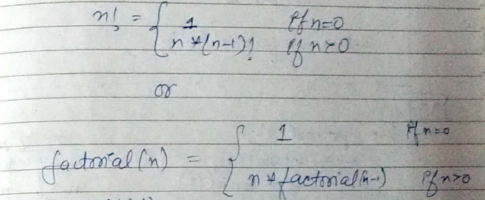
Calculate Factorial of the number using Recursion.
Introduction to Stack
factorial of n → (n!) = n * n-1 – n-2* ………*2*1
n!= n* (n-1)! And 0! = 1

Slide 63
Factorial of an integer number using recursive function
Introduction to Stack
void main(){
int n;
long int facto; scanf(“%d”,&n); facto=factorial(n);
printf(“%d!=%ld”,n,facto);
}
long int factorial(int n){
if(n==0){
return 1;
}else{
return n*factorial(n-1);
}
Factorial(5)=
5*Factorial(4)=
5*(4*Factorial(3))= 5*(4*(3*Factorial(2)=
5*(4*(3*(2*Factorial(1))))=
5*(4*(3*(2*(1*Factorial(0)))))=
5*(4*(3*(2*(1*1))))= 5*(4*(3*(2*1)))=
5*(4*(3*2))= 5*(4*6)= 5*24=
120

Slide 64
Recursion
Program for Fibonacci numbers
The Fibonacci numbers are the numbers in the following integer sequence.
0, 1, 1, 2, 3, 5, 8, 13, 21, 34, 55, 89, 144, ……..
In mathematical terms, the sequence Fn of Fibonacci numbers is defined by the recurrence relation Fn = Fn-1 + Fn-2 with seed values F0 = 0 and F1 = 1.

Slide 65
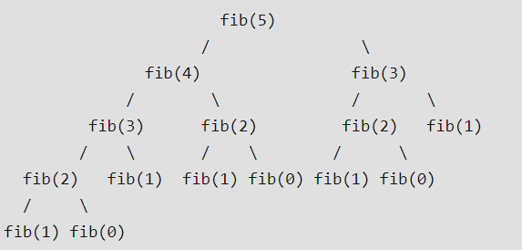
Recursion
//Fibonacci Series using Recursion
#include<stdio.h>
int fib(int n)
{
if (n <= 1)
return n;
return fib(n-1) + fib(n-2);
}
int main () {
int n = 5;
printf("%d", fib(n));
getchar();
return 0;
}

Slide 66
Recursion Pros and Cons
Introduction to Stack
Pros
The code may be much easier to write.
To solve some problems which are naturally recursive such as tower of Hanoi.
Cons
Recursive functions are generally slower than non-recursive functions.
May require a lot of memory to hold intermediate results on the system stack.
It is difficult to think recursively so one must be very careful when writing recursive functions.

Slide 67
Recursion

Slide 68
Recursion
Python Program for Binary Search (Recursive and Iterative)
This search algorithm takes advantage of a collection of elements that is already sorted by ignoring half of the elements after just one comparison.
Compare x with the middle element.
If x matches with the middle element, we return the mid index.
Else if x is greater than the mid element, then x can only lie in the right (greater) half subarray after the mid element. Then we apply the algorithm again for the right half.
Else if x is smaller, the target x must lie in the left (lower) half. So we apply the algorithm for the left half.

Slide 69
Recursion
# program for recursive binary search.
# Returns index of x in arr if present, else -1
def binary_search(arr, low, high, x):
# Check base case
if high >= low:
mid = (high + low) // 2
# If element is present at the middle itself
if arr[mid] == x:
return mid
# If element is smaller than mid, then it can only
# be present in left subarray
elif arr[mid] > x:
return binary_search(arr, low, mid - 1, x)
# Else the element can only be present in right subarray
else:
return binary_search(arr, mid + 1, high, x)
else:
# Element is not present in the array
return -1
# Test array
arr = [ 2, 3, 4, 10, 40 ]
x = 10
# Function call
result = binary_search(arr, 0, len(arr)-1, x)
if result != -1:
print("Element is present at index", str(result))
else:
print("Element is not present in array")

Slide 70
Recursion
# Iterative Binary Search Function
# It returns index of x in given array arr if present, else returns -1
def binary_search(arr, x):
low = 0
high = len(arr) - 1
mid = 0
while low <= high:
mid = (high + low) // 2
# If x is greater, ignore left half
if arr[mid] < x:
low = mid + 1
# If x is smaller, ignore right half
elif arr[mid] > x:
high = mid - 1
# means x is present at mid
else:
return mid
# If we reach here, then the element was not present
return -1
# Test array
arr = [ 2, 3, 4, 10, 40 ]
x = 10
# Function call
result = binary_search(arr, x)
if result != -1:
print("Element is present at index", str(result))
else:
print("Element is not present in array")

Slide 71
Tower of Hanoi Problem
Introduction to Stack
Tower of Hanoi is a mathematical puzzle where we have three rods and n disks.

Slide 72
Tower of Hanoi Problem
Introduction to Stack
The objective of the puzzle is to move the entire stack to another rod, obeying the following simple rules:
Only one disk can be moved at a time.
2) Each move consists of taking the upper disk from one of the stacks and placing it on top of another stack i.e. a disk can only be moved if it is the uppermost disk on a stack.
3) No disk may be placed on top of a smaller disk.

Slide 73
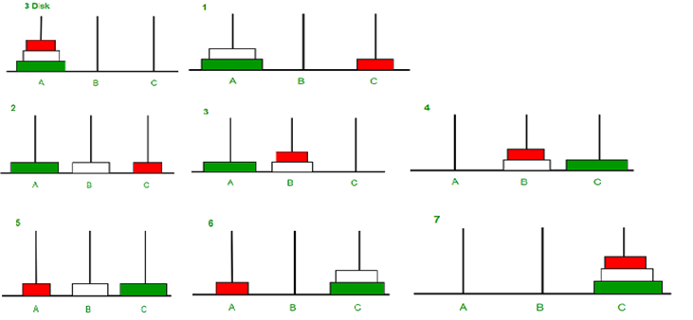
Tower of Hanoi Problem Illustration
Introduction to Stack

Slide 74
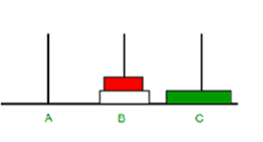
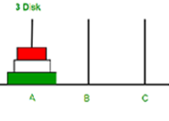
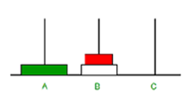
Tower of Hanoi Algorithm Concept
Introduction to Stack

Slide 75
A recursive algorithm for Tower of Hanoi can be driven as follows
Introduction to Stack
void towerOfHanoi(int n, char source, char aux, char dest)
{
if (n == 1)
{
printf("\n Move disk 1 from rod %c to rod %c", source, dest);
return;
}
towerOfHanoi(n-1, source, dest, aux);
printf("\n Move disk %d from rod %c to rod %c", n, source, dest);
towerOfHanoi(n-1, aux, source, dest);
}

Slide 76
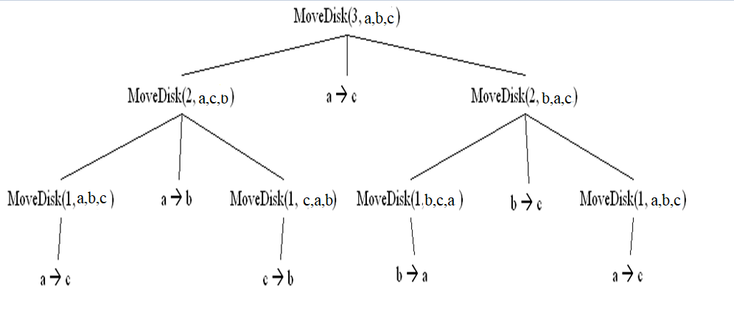
Introduction to Stack

Slide 77
Recursion
Difference Between Recursion and Iteration
BASIS FOR COMPARISON | RECURSION | ITERATION
Basic | The statement in a body of function calls the function itself. | Allows the set of instructions to be repeatedly executed.
Format | In recursive function, only termination condition (base case) is specified. | Iteration includes initialization, condition, execution of statement within loop and update (increments and decrements) the control variable.
Termination | A conditional statement is included in the body of the function to force the function to return without recursion call being executed. | The iteration statement is repeatedly executed until a certain condition is reached.

Slide 78
Recursion
Difference Between Recursion and Iteration
BASIS FOR COMPARISON | RECURSION | ITERATION
Condition | If the function does not converge to some condition called (base case), it leads to infinite recursion. | If the control condition in the iteration statement never become false, it leads to infinite iteration.
Infinite Repetition | Infinite recursion can crash the system. | Infinite loop uses CPU cycles repeatedly.
Applied | Recursion is always applied to functions. | Iteration is applied to iteration statements or "loops".
Stack | The stack is used to store the set of new local variables and parameters each time the function is called. | Does not uses stack.
Overhead | Recursion possesses the overhead of repeated function calls. | No overhead of repeated function call.

Slide 79
Recursion
Difference Between Recursion and Iteration
BASIS FOR COMPARISON | RECURSION | ITERATION
Speed | Slow in execution. | Fast in execution.
Size of Code | Recursion reduces the size of the code. | Iteration makes the code longer.

Slide 80
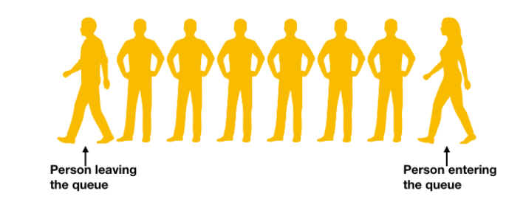
Queue
Queue
Queue is Linear Data Structure
It follows First In First Out(FIFO) principal
It has two pointers front and rear e.g.:
Front
Rear

Slide 81
Implementation of Queue
Queue
1. Using Array
2. Using Link List
Application of Queue
Queues are used in a lot of applications, few of them are:
Queue is used to implement many algorithms like Breadth First Search (BFS), etc.
It can be also used by an operating system when it has to schedule jobs with equal priority
Customers calling a call center are kept in queues when they wait for someone to pick up the calls

Slide 82
Insertion in Queue using Array
Queue
A[0]
A[1]
A[2]
A[3]
A[4]
F=R=(-1)
10
A[0]
A[1]
A[2]
A[3]
A[4]
F=R=0
10
20
A[0]
A[1]
A[2]
A[3]
A[4]
F=0
R=1

Slide 83
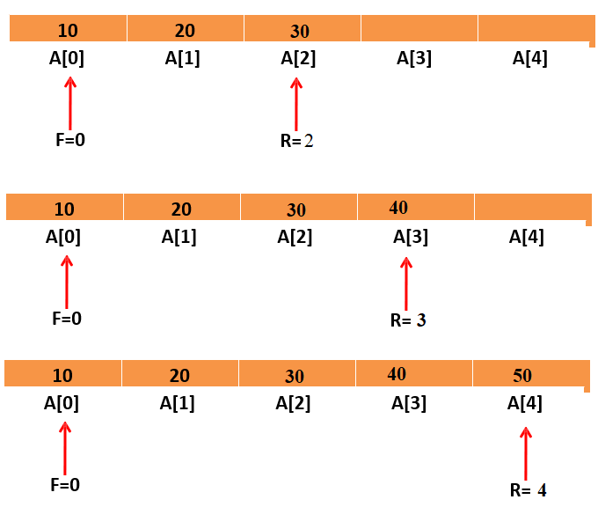
Queue

Slide 84
Operations on Queue
Queue
Insertion: Algorithm:
Step 1: If REAR = MAX – 1 then
Write “Queue is Overflow”
Goto step 4
[End of IF]
Step 2: IF FRONT=-1 and REAR=-1
SET FRONT=REAR=0
ELSE
SET REAR=REAR+1 [END OF IF]
Step 3: SET QUEUE [REAR] = NUM
Step 4: EXIT

Slide 85
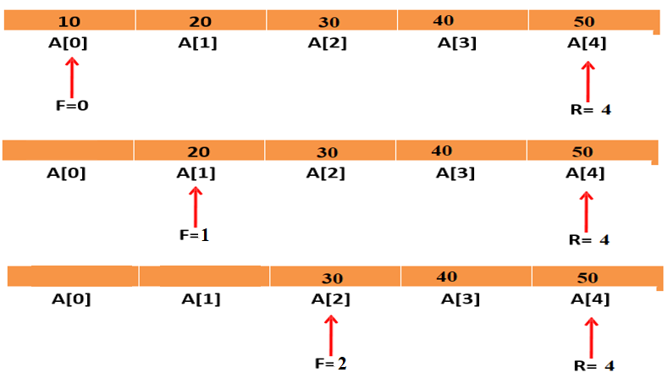
Example of Deletion in Queue
Queue
10
20
A[0]
A[1]
A[2]
A[3]
A[4]
F=0
R=1
20
A[0]
A[1]
A[2]
A[3]
A[4]
F=R=1

Slide 86
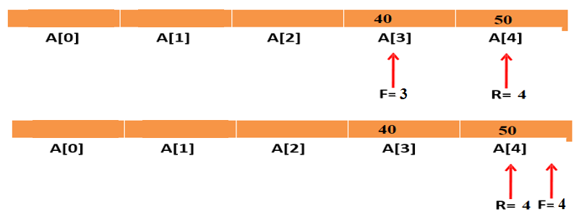
Example of Deletion in Queue
Queue
10
20
A[0]
A[1]
A[2]
A[3]
A[4]
F=0
R=1
20
A[0]
A[1]
A[2]
A[3]
A[4]
F=R=1

Slide 87
Operations on Queue
Queue
Deletion: Algorithm:
Step 1: IF FRONT = -1 OR FRONT>REAR
Write “Queue is Underflow”
ELSE
SET VAL=QUEUE [FRONT]
FRONT = FRONT + 1 [END OF IF]
Step 2: EXIT

Slide 88
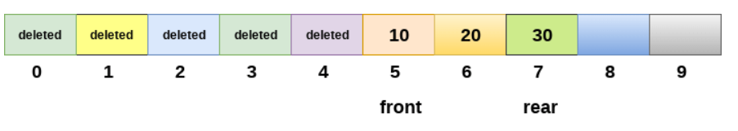
Queue
Drawback of array implementation
Although, the technique of creating a queue is easy, but there are some drawbacks of using this technique to implement a queue.
Static Array Size
Memory wastage : The space of the array, which is used to store queue elements, can never be reused to store the elements of that queue because the elements can only be inserted at front end and the value of front might be so high so that, all the space before that, can never be filled.

Slide 89
Types Of Queue
Queue
Circular Queue
Priority Queue
Deque
Multiple Queue

Slide 90
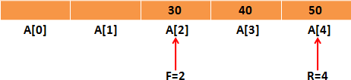
Why Circular Queue is needed?
Queue
Problem:
– Wastage of memory in standard queue in DEQUEUE operation

Slide 91
What is Circular Queue?
Queue
The Arrangement of the elements Q[0], Q[1], ..,Q[n] in a circular fashion with Q[1] following Q[n] is called Circular Queue.
The last node is connected to first node to make a circle.
Initially, Both Front and Rear pointers points to the beginning of the array.
It is also known as “Ring Buffer”.

Slide 92
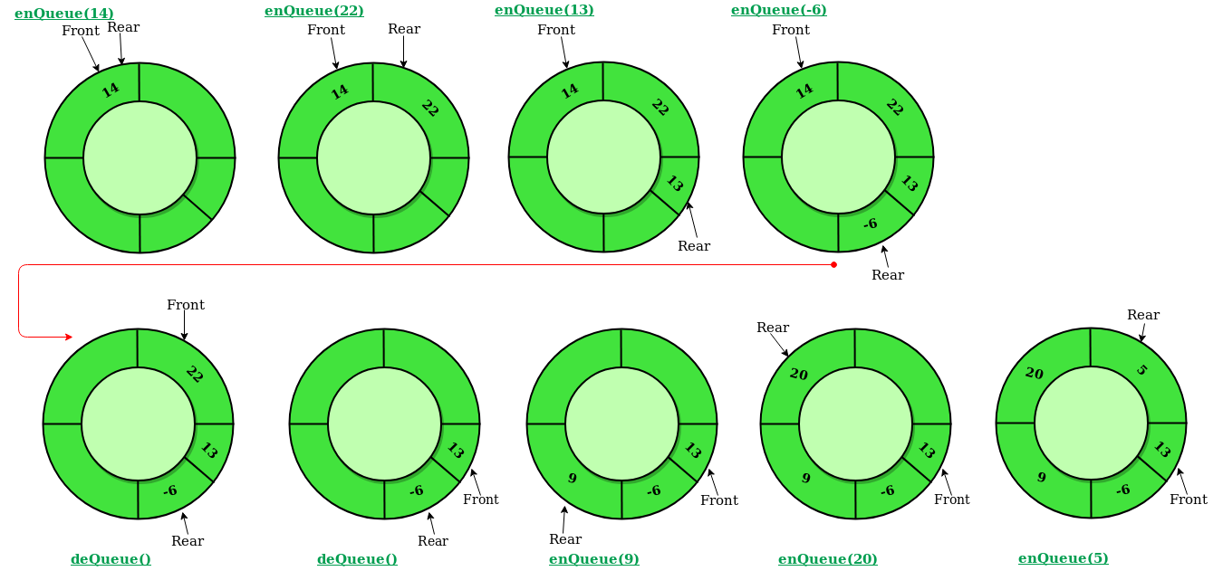
Queue

Slide 93
Insertion in circular queue
Queue
Step 1 - Check whether Circular queue is FULL. Front == (Rear+1)%Max
Step 2 - If it is FULL, then display "Queue is FULL!!! Insertion is not possible!!!" and terminate the function.
Step 3 - If it is NOT FULL, then check Front == -1,
then Front =0.
Step 4 - Rear = (Rear+1)%max, set Cqueue[Rear] = value.

Slide 94
Deletion in circular queue
Queue
Step 1 - Check whether queue is EMPTY. (front == -1)
Step 2 - If it is EMPTY, then display “Circular Queue is EMPTY!!! Deletion is not possible!!!" and terminate the function.
Step 3 - Val = Cqueue[front];
Step 4 – if(front==rear)
front = rear = -1;
Step 5 – front = (front+1)%Max;
Step 6 – return Val

Slide 95
Application of Circular Queue
Queue
Traffic light functioning is the best example for circular queues. The colors in the traffic light follow a circular pattern.
In page replacement algorithms, a circular list of pages is maintained and when a page needs to be replaced, the page in the front of the queue will be chosen.

Slide 96
Queue
display() - Displays the elements of a Circular Queue
We can use the following steps to display the elements of a circular queue...
Step 1 - Check whether queue is EMPTY. (front == -1)
Step 2 - If it is EMPTY, then display "Queue is EMPTY!!!" and terminate the function.
Step 3 - If it is NOT EMPTY, then define an integer variable 'i' and set 'i = front'.
Step 4 – for(i = front; i!=rear; i = (i+1)%Max)
Print Cqueue[i];
end
print(queue[rear]);
Step 5 - Exit

Slide 97
Priority Queue
Queue
In priority queue, each element is assigned a priority.
Priority of an element determines the order in which the elements will be processed.
Rules:
An element with higher priority will processed before an element with a lower priority.
Two elements with the same priority are processed on a First Come First Serve basis.

Slide 98
Queue
Priority Queue
DATA | PRIORTY NUMBER
A | 5
B | 1
D | 3
E | 2
F | 8
G | 6

Slide 99
Types of Priority Queue
Queue
Ascending Priority Queue
In this type of priority queue, elements can be inserted into any order but only the smallest priority element can be removed.
Descending Priority Queue
In this type of priority queue, elements can be inserted into any order but only the largest priority element can be removed.

Slide 100
Array Representation of Priority Queue
Queue
Insertion Operation:
While inserting elements in priority queue we will add it at the appropriate position depending on its priority
It is inserted in such a way that the elements are always ordered either in Ascending or descending sequence

Slide 101
Queue
Array Insertion of Priority Queue
DATA | PRIORTY NUMBER
A | 5
B | 1
D | 3
E | 2
F | 8
G | 6
DATA | PRIORTY NUMBER
B | 1
E | 2
D | 3
A | 5
G | 6
F | 8

Slide 102
Array Representation of Priority Queue
Queue
Deletion Operation:
While deletion, the element at the front is always deleted.
DATA | PRIORTY NUMBER
B | 1
E | 2
D | 3
A | 5
G | 6
F | 8

Slide 103
Application of Priority Queue
Queue
Prim's algorithm implementation can be done using priority queues.
Dijkstra's shortest path algorithm implementation can be done using priority queues.
A* Search algorithm implementation can be done using priority queues.
Priority queues are used to sort heaps.
Priority queues are used in operating system for load balancing and interrupt handling.
Priority queues are used in huffman codes for data compression.
In traffic light, depending upon the traffic, the colors will be given priority.

Slide 104
Deque / Double Ended Queue
Queue
A list in which elements can be inserted or deleted either end
It is also known as “Head-Tail Linked List”
It has two pointers LEFT and RIGHT, which point to either end of the deque.
Dequeue can be implemented using Circular Array or a Circular doubly linked list where Dequeue[n-1] is followed by Dequeue[0]

Slide 105
Types of Deque
Queue
Input Restricted Deque:-
In this dequeue, insertion can be done only at one of the end, while deletion can be done from both ends.
Output Restricted Deque:-
In this dequeue, deletion can be done only at one of the ends, while insertions can be done on both ends.

Slide 106
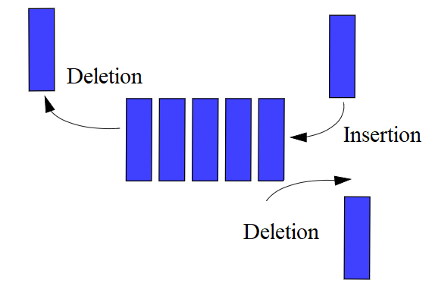
Queue
Input Restricted Deque

Slide 107
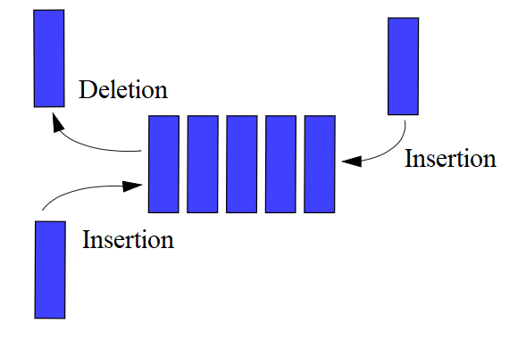
Queue
Output Restricted Deque

Slide 108
Queue
Insert At Right
void insert_right()
{
int added_item;
if((left == 0 && right == MAX-1) || (left == right+1))
{ printf("Queue Overflow\n");
return;}
if (left == -1) /* if queue is initially empty */
{ left = 0;
right = 0;}
else
if(right == MAX-1) /*right is at last position of queue */
right = 0;
else
right = right+1;
printf("Input the element for adding in queue : ");
scanf("%d", &added_item);
deque_arr[right] = added_item ;
}

Slide 109
Queue
Insert At Left
void insert_left()
{
int added_item;
if((left == 0 && right == MAX-1) || (left == right+1))
{ printf("Queue Overflow \n");
return; }
if (left == -1)/*If queue is initially empty*/
{
left = 0;
right = 0; }
else
if(left== 0)
left=MAX-1;
else
left=left-1;
printf("Input the element for adding in queue : ");
scanf("%d", &added_item);
deque_arr[left] = added_item ;
}

Slide 110
Queue
Delete from Left
void delete_left()
{
if (left == -1)
{
printf("Queue Underflow\n");
return ;
}
printf("Element deleted from queue is : %d\n",deque_arr[left]);
if(left == right) /*Queue has only one element */
{ left = -1;
right=-1;
}
else
if(left == MAX-1)
left = 0;
else
left = left+1;
}

Slide 111
Queue
Delete from right
void delete_right()
{
if (left == -1)
{
printf("Queue Underflow\n");
return ;
}
printf("Element deleted from queue is : %d\n",deque_arr[right]);
if(left == right) /*queue has only one element*/
{ left = -1;
right=-1; }
else
if(right == 0)
right=MAX-1;
else
right=right-1;
}

Slide 112
Queue
Application of Deque – Deque is a Double Ended Queue where operations(Add/Remove) can be made on both ends of the queue.
A web browser's history. Recently visited URLs are added to the front of the deque, and the URL at the back of the deque is removed after some specified number of insertions at the front.
Another common application of the deque is storing a software application's list of undo operations.
Have you see moneyControl App, it will show the stocks you last visited, it will remove the stocks after some time and will add the latest ones.

Slide 113
Faculty Video Links, Youtube & NPTEL Video Links and Online Courses Details
Self Made Video Link:
Youtube/other Video Links
https://www.youtube.com/watch?v=PGWZUgzDMYI&list=PLBF3763AF2E1C572F&index=3
https://www.youtube.com/watch?v=zp6pBNbUB2U&list=PLdo5W4Nhv31bbKJzrsKfMpo_grxuLl8LU&index=41
https://www.youtube.com/watch?v=UpvDOm3prfI

Slide 114
Daily Quiz
What is Stack and where it can be used?
What is a Queue, how it is different from stack and how is it implemented?
What are Infix, prefix, Postfix notations?
How to implement a stack using queue?
How to implement a queue using stack?
What is recursion and when should you use it?
Write a function to copy string (Iterative and Recursive).
Check if a number is Palindrome using recursion
Reverse a stack using recursion.
Sort a stack using recursion.

Slide 115
Assignment
Q 1 What do you understand by stable and in place sorting?
Q 2 Consider the following infix expression and convert into reverse polish notation using stack. A + (B * C – (D / E ^ F) * H)
Q3 Recursive function to delete k-th node from linked list.
Q4. Write the C Program to implement queue using stack.
Q5. The initial configuration of a queue is p,q,r,s (‘p’ is in the front end ). To get the configuration s,r,q,p, how many minimum dequeue and enqueue are required?
Q.6 What is Tower of Hanoi Problem? Explain the solution of Tower of Hanoi Problem where discs are 4 and pegs is 3.

Slide 116
Assignment
Q7. What is tail recursion? Write recursive function for tower of Hanoi problem and remove tail recursion, if any, from it.
Q8. Write the algorithm for insertion in a circular queue using array.
Q9. Define doubly ended queue.
Q10. Define Priority Queue.

Slide 117
MCQ s
1. Process of inserting an element in stack is called ____________
a) Create
b) Push
c) Evaluation
d) Pop
2. Process of removing an element from stack is called __________
a) Create
b) Push
c) Evaluation
d) Pop

Slide 118
MCQ s
3. In a stack, if a user tries to remove an element from empty stack it is called _________
a) Underflow
b) Empty collection
c) Overflow
d) Garbage Collection
4. Pushing an element into stack already having five elements and stack size of 5, then stack becomes
a) Overflow
b) Crash
c) Underflow
d) User flow

Slide 119
MCQ s
5. Which of the following applications may use a stack?
a) A parentheses balancing program
b) Tracking of local variables at run time
c) Compiler Syntax Analyzer
d) Data Transfer between two asynchronous process
6. 1. Recursion is a method in which the solution of a problem depends on ____________
a) Larger instances of different problems
b) Larger instances of the same problem
c) Smaller instances of the same problem
d) Smaller instances of different problems

Slide 120
MCQ s
7. Recursion is similar to which of the following? a) Switch Case b) Loop c) If-else d) if elif else
8. A queue follows __________ a) FIFO (First In First Out) principle b) LIFO (Last In First Out) principle c) Ordered array d) Linear tree

Slide 121
MCQ s
9. If the elements “A”, “B”, “C” and “D” are placed in a queue and are deleted one at a time, in what order will they be removed? a) ABCD b) DCBA c) DCAB d) ABDC
10. A data structure in which elements can be inserted or deleted at/from both the ends but not in the middle is? a) Queue b) Circular queue c) Dequeue d) Priority queue

Slide 122
Questions
Q1. What is Stack and where it can be used?
Q2. What is a Queue, how it is different from stack and how is it implemented?
Q3. What are Infix, prefix, Postfix notations?
Q4. How to implement a stack using queue?
Q5. How to implement a queue using stack?
Q6. What is recursion and when should you use it?
Q7. Write a function to copy string (Iterative and Recursive).
Q8. Check if a number is Palindrome using recursion
Q9. Reverse a stack using recursion.
Q10. Sort a stack using recursion.

Slide 123
Glossary Questions
1. In a stack, if a user tries to remove an element from empty stack it is called _________
a) Underflow
b) Empty collection
c) Overflow
d) Garbage Collection
2. Pushing an element into stack already having five elements and stack size of 5, then stack becomes
a) Overflow
b) Crash
c) Underflow
d) User flow

Slide 124
Glossary Questions
3. Which of the following applications may use a stack?
a) A parentheses balancing program
b) Tracking of local variables at run time
c) Compiler Syntax Analyzer
d) Data Transfer between two asynchronous process
4. Recursion is a method in which the solution of a problem depends on ____________
a) Larger instances of different problems
b) Larger instances of the same problem
c) Smaller instances of the same problem
d) Smaller instances of different problems

Slide 125
Glossary Questions
5. Recursion is similar to which of the following? a) Switch Case b) Loop c) If-else d) if elif else
6. A queue follows __________ a) FIFO (First In First Out) principle b) LIFO (Last In First Out) principle c) Ordered array d) Linear tree

Slide 126
Glossary Questions
7.If the elements “A”, “B”, “C” and “D” are placed in a queue and are deleted one at a time, in what order will they be removed? a) ABCD b) DCBA c) DCAB d) ABDC
8. A data structure in which elements can be inserted or deleted at/from both the ends but not in the middle is? a) Queue b) Circular queue c) Dequeue d) Priority queue

Slide 127
Expected Questions for University Exam
Q1. Define priority queue.
Q2. Write a program in C for implementation of a queue. Your program should at least contain ADD, CREATE. DELETE, FULL and EMPTY functions.
Q3. If an array is defined as int a[10] [20] in C, devise a formula to calculate the address of an any variable say a[i] [j], for any valid value of i and j.
Q4. Write a program to implement STACK using linked list.
Q5. If the Tower of Hanoi is operated on n=10 disks, calculate the total number of moves.
Q6. Differentiate between overflow and underflow condition in a linked list.

Slide 128
Expected Questions for University Exam
Q7. Convert the following infix expression into postfix expression:
B-C/D+A*(F-G/H).
Q8.Write a program in C to compute the factorial of given number recursively.
Q9.Write a Program in C to implement all operations of a Stack using array.
Q10.Define Dequeue.
Q11. Write the syntax to check whether a given circular queue is full or empty?
Q12. What is Recursion? Give disadvantages of recursion.
Q13.Explain Tower of Hanoi problem and write a recursive algorithm to solve it.
Q14. Explain how a circular queue can be implemented using arrays. Write all functions for circular queue operations.

Slide 129
Last Year Question Paper

Slide 130
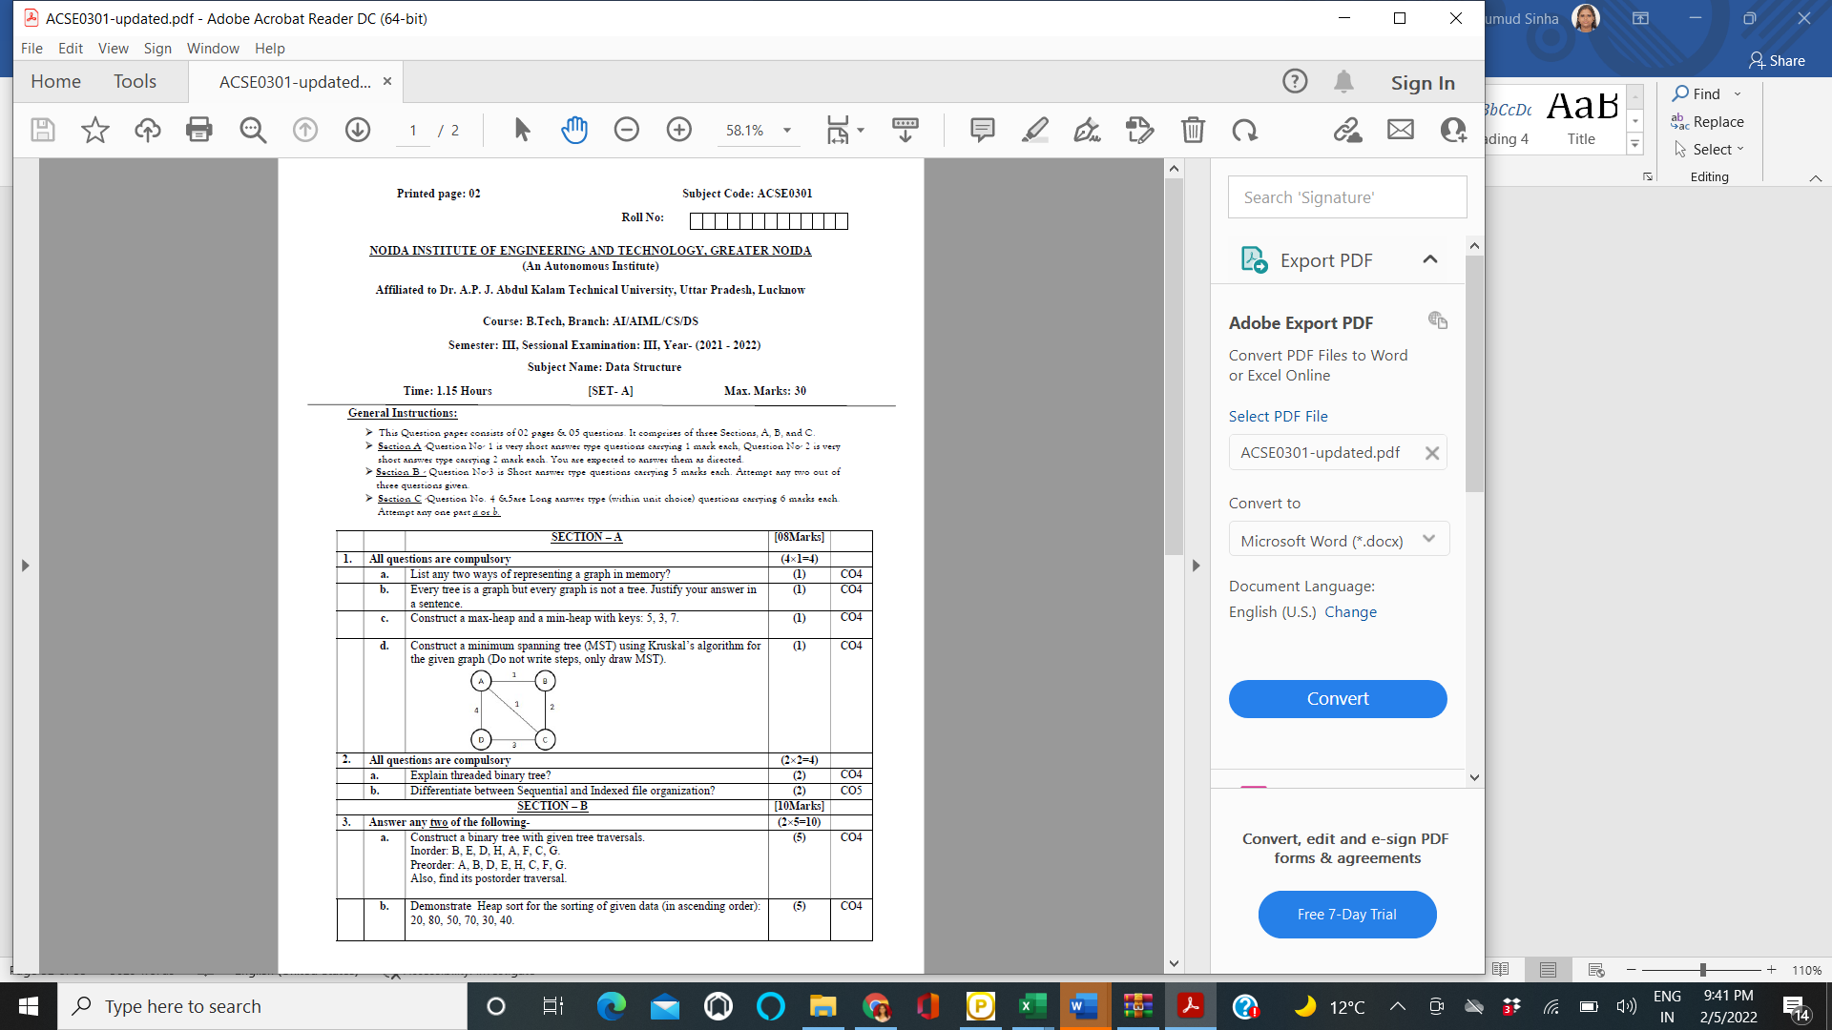

Slide 131
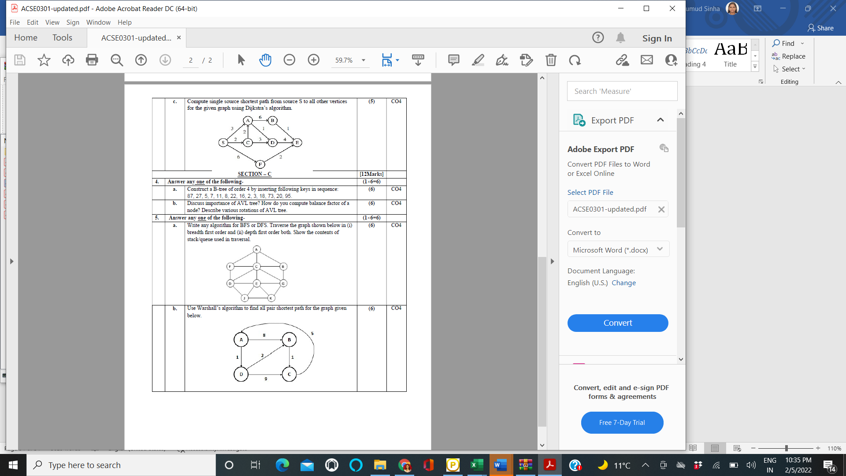

Slide 132
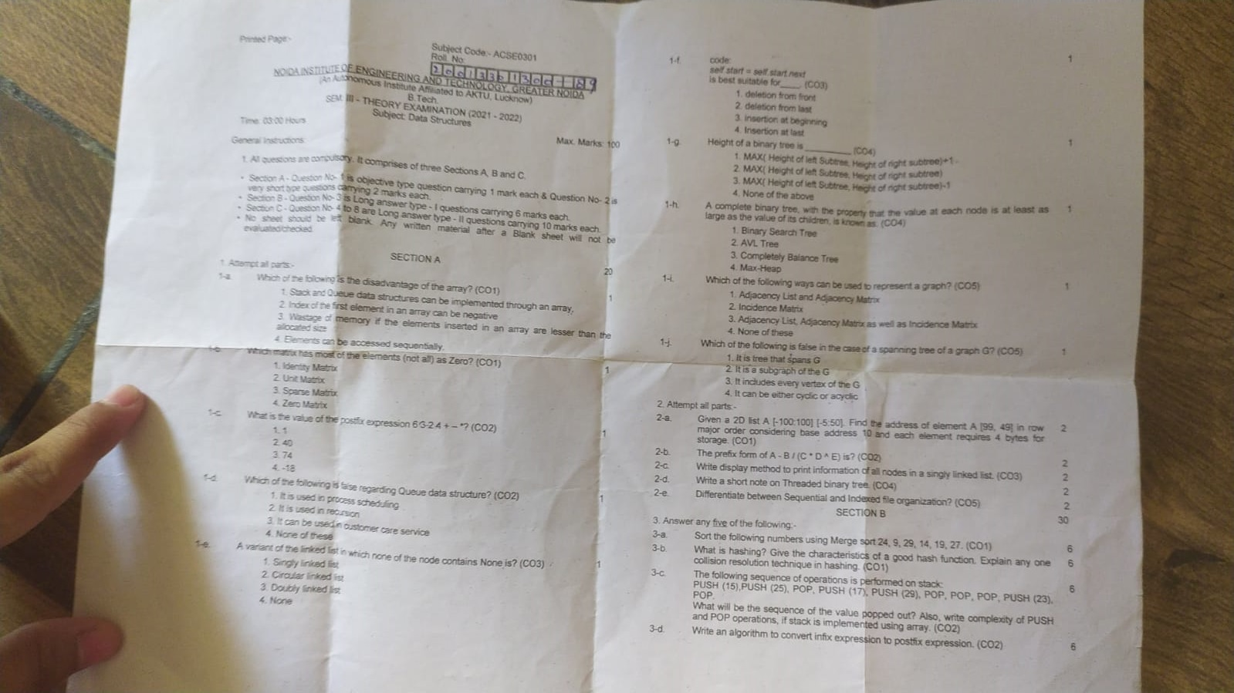
Last year Question Paper

Slide 133
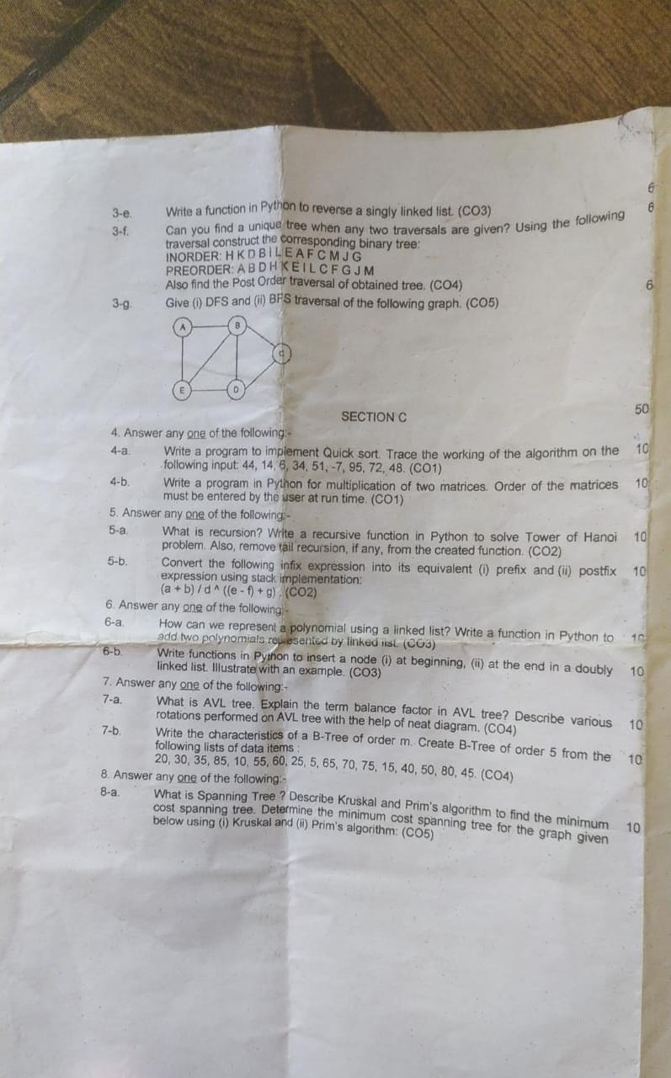
Last year Question Paper

Slide 134
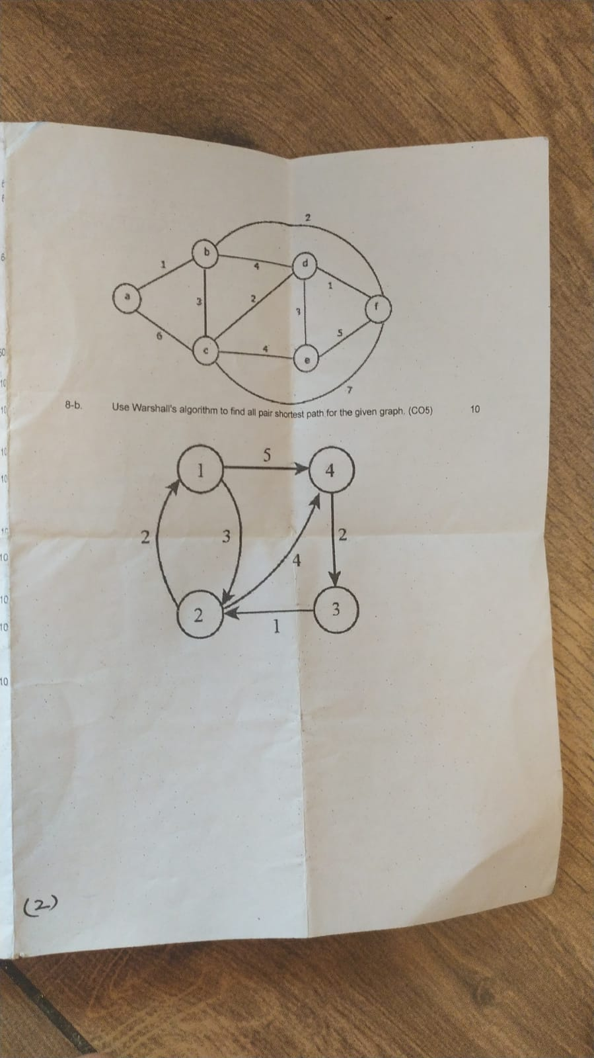
Last year Question Paper

Slide 135
References
[1] Aaron M. Tenenbaum, Yedidyah Langsam and Moshe J. Augenstein, “Data Structures Using C and C++”, PHI Learning Private Limited, Delhi India
[2] Horowitz and Sahani, “Fundamentals of Data Structures”, Galgotia Publications Pvt Ltd Delhi India.
[3] Lipschutz, “Data Structures” Schaum’s Outline Series, Tata McGraw-hill Education (India) Pvt. Ltd.
[4] Thareja, “Data Structure Using C” Oxford Higher Education.
[5] AK Sharma, “Data Structure Using C”, Pearson Education India.

Slide 136
Thank you

